Slide 1


Slide 2

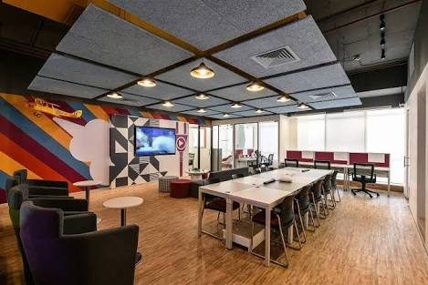
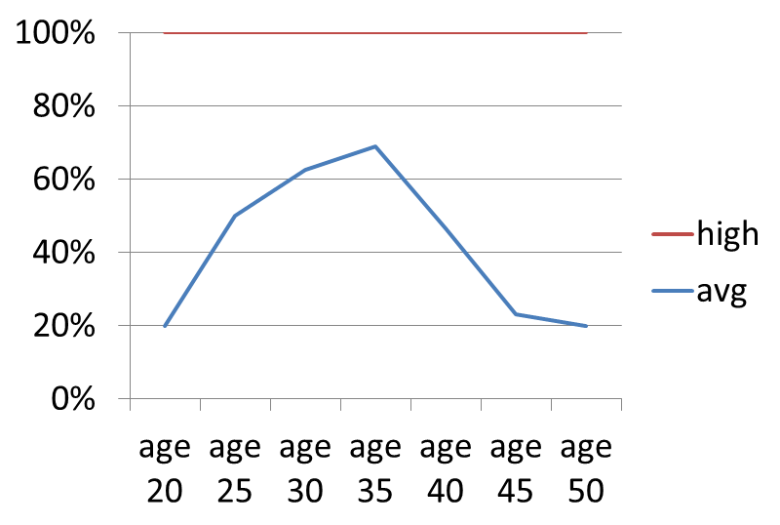
Problem :
Difficulty in buying new technology products at reasonable prices which are Reliable.
Potentials customers :-
Small scale start up’s
General Public

Slide 3




Solution: A platform which enables both buying and selling of after sale products.
Ecommerce Platform
Hold ON
Validation of product
Warranty and 48hr return
Instant cash

Slide 4
Draw Product:
Visit via website
Switch F
Buying products
Validating and pricing
Range(50%-100%)
Selling products
Assuring the warranty
Managing hold on’s
Visit website
Dunzo pickup/delivery
Seller
Walk-in to store
Buyers
Walk-in store
Selling items
Buy product
Hold on
Exchange policy
voucher for claim
Instant cash

Slide 5


Competition Analysis:

Slide 6

MARKET
Electronics , gaming Technology seekers/users are our customers.
Addressable customers are people living in Hyderabad In ORR .
Age group between 15 to 50 years old.

Slide 7


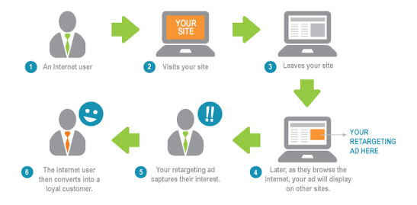
Marketing Plan:
Retargeting
&
Remarketing

Slide 8
REVENUE MODEL
Depending on Demand margin of profit ranges from 30%-40% with selling price of each products yielding a profit of 20% -100%
Hold on payments.
Adding advertisement's onsite and instore.

Slide 9
Financial plan:
Equity shares: 10 lakhs.
Loan under govt. scheme: 20 lakhs.
Total expenses : 6.5 lakhs.
Start up total budget: 30 lakhs.
1st year Revenue: 15lakhs.
2nd year(based on the rotation )expected
to reach BEP till ending 20 lakhs.
3rd year revenue :up to 30 lakhs.

Slide 10
Switch - F Team:
Shaik Shoaib Uddin (B.TECH - IV Year)
FoundeR
G.Ramu
(B.TECH - IV Year)
Co-founder
Pushpa
(B.TECH - IV Year)
Managing Director.
p.Kranthi Kumar
(B.TECH - IV Year)
Chief Technology officer.

